Slide 1
SWAN Material shortage 8D report
Prepared By: KT/Hop Nguyen
Reviewed By: Ben Trinh
Tony Tu / Ken
Date: 2023-12-04

Slide 2
D1
Establish the Team
Team Leader
Team Member
Sales: Miya Wang
PM: An Tran
PQE: Toney Tu, Ken
PE : Jack Han
Kitting: Hop Nguyen
ME: Cheng Lun
  Operation leader: David Yin
  QA leader: CB Lin
Notes:
MA5800-X7#display cable modem <MAC> detail

Slide 3
D2
Description the Problem
Issue Description (5W2H)
When | 2023-11-18
Who | Fii’s issue (KITTING & MPM) and Dreamus
Where | Fii production line
What | The latest MO release, Material is shortage →shipping plan was impacted
Why | Incoming materials from Dreamus were mixed
How | Material PN: 352.00191.005LT SPEAKER stock should be 128 PCS but actually no stock.
How many | Material PN: 352.00191.005LT*128 PCS

Slide 4
D3
Containment Action
Immediately meeting with CFT team to find out the root causes and take out solution.
Done on 18th Nov (Owner: KT: Hop Nguyen /PC: Sara Le/ PM: An Tran, PD: Wen Yong)
Report to customer to help prepare material to cover this quantity.
Done on 23th Nov (Owner: PM: An Tran/ MPM: Zenda Nguyen)
Notes:
5.26891E-07 4.96855E-07

Slide 5
D4
Root Cause Analysis
Risk
Review work process: 352.00191.005LT SPEAKER
Normal
WH receive materials from vendor
KT receive from WH
KT release material to production line
Production line online
MO settlement
IQC inspection
MO offline
The incoming materials are in full boxes, the quantity is confirmed according to the outside box label.
The incoming materials aren’t full boxes, the materials will be counted quantity 100%.
Random inspection based on proportion
The incoming materials are in full boxes, the quantity is confirmed according to the outside box label.
The incoming materials aren’t full boxes, the materials will be counted quantity 100%.
The incoming materials are in full boxes, it will be released to production line as full boxes.
The incoming materials aren’t in full boxes, KT and production line will count 100%.
The production line receives the materials and produces them directly.
NG materials in production line can not handle in time. (NG materials handling process: NG materials are found in the production line, →notify to ME/SQE for confirmation → returned to MRB for scrap)
For continuous production of MO, inventory and consumption is calculated based on the last MO.
Kitting balanced material when MO offline not find out material damaged in standard. MO closed
WH got material from vendor didn’t detect in time and released material to KITTING directly
KT receive materials according to the full boxes and can’t detect mixing of incoming materials.
MO manufacture continuously, so the shortage of materials will not be detected and handle in time.
Conclusion: 1. Mixing of incoming materials can’t be detected.
Notes:
5.26891E-07 4.96855E-07

Slide 6
Manage B&S materials’ quantities at WH&KT
1. Manage quantities at WH(Warehouse)
The incoming materials are in full boxes, the quantity is confirmed according to the outside box label.
The incoming materials aren’t full boxes, the materials will be counted quantity 100% .
WH check qty daily(full box is checked qty by label on the box, old qty will be counted 100%)
The materials countable will release to KT only enough qty follow WO(Work Order) demand and uncountable qty material will be released minimum packing qty
2. Manage quantities at KT(Kitting)
Materials are in full boxes, KT will release to production line as full boxes. Unfull boxes, KT and production line will count 100%. Materials countable will be released to the production line only enough qty follow WO(Work Order) demand and uncountable qty material will be released minimum packing qty.
The leave material will be returned if have when finish production.
KT use the system Distribution material to release material to the line and qty was deduct on time.

Slide 7
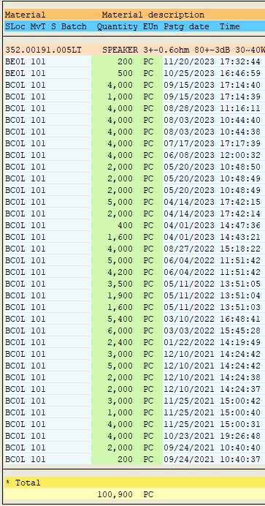
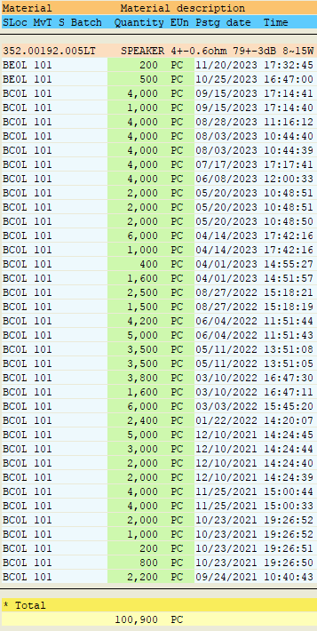
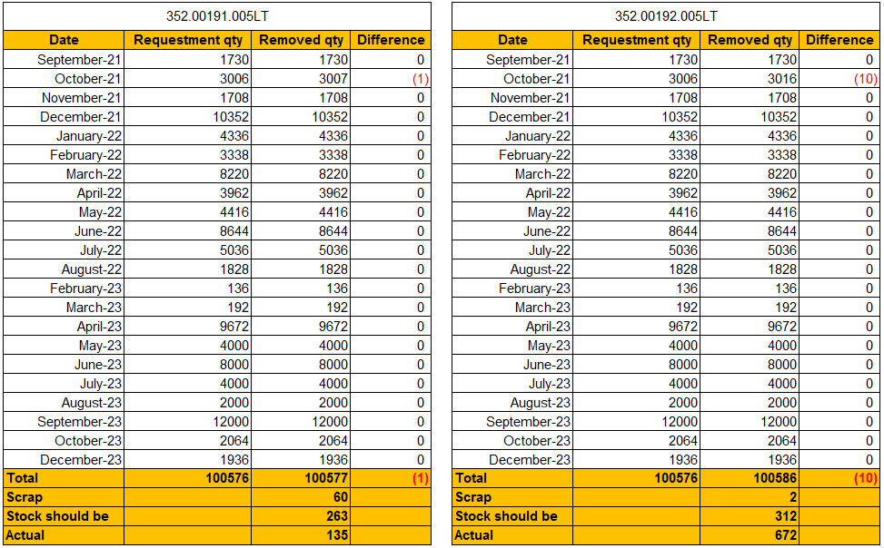
D4
Root Cause Analysis
Incoming materials record:
From Sep 2021 to Nov 2023, Incoming material quantity:
352.00191.005LT*100900pcs
352.00192.005LT*100900pcs
II. Materials check out record:
From Sep 2021 to Nov 2023,
352.00191.005LT checked out quantity 100577 pcs + scrap 60pcs, total 100637 pcs, stock should be 263pcs, but actual 135pcs, less 128pcs.
352.00192.005LT checked out quantity 100586 pcs + scrap 2pcs, total 100588 pcs, stock should be 312pcs, but actual 672pcs, more 360pcs.
III. On Oct 18th The last MO online material were released to the production line and find out less 128pcs (2 boxes) 352.00191.005LT and 352.00192.005LT more 360 (2boxes) .
Root cause：
Incoming material mixing
Notes:
5.26891E-07 4.96855E-07

Slide 8
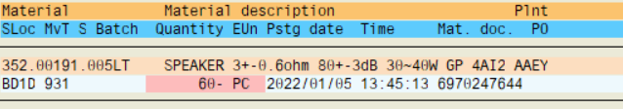

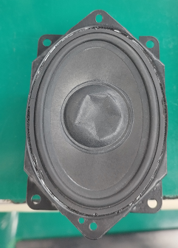
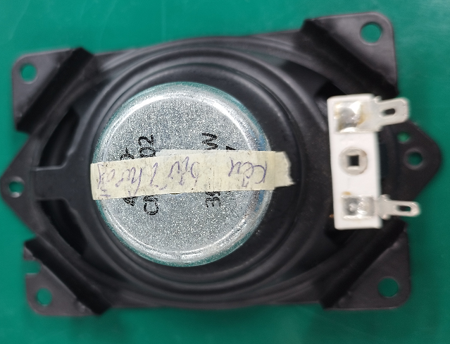
D4
Root Cause Analysis
The scrap history
1. 352.00191.005LT SPEAKER 3+-0.6ohm
The scrap reason:
reason for being scrapped came from many reasons. This quantities were accumulated before,
Some quantities are material NG(Function, cosmetic, etc) or operation error…
These quantities were scrapped last year, we didn't save pictures or scrap report.
2. 352.00192.005LT SPEAKER 4+-0.6ohm
cosmetic
Sound abnormal
Notes:
5.26891E-07 4.96855E-07

Slide 9
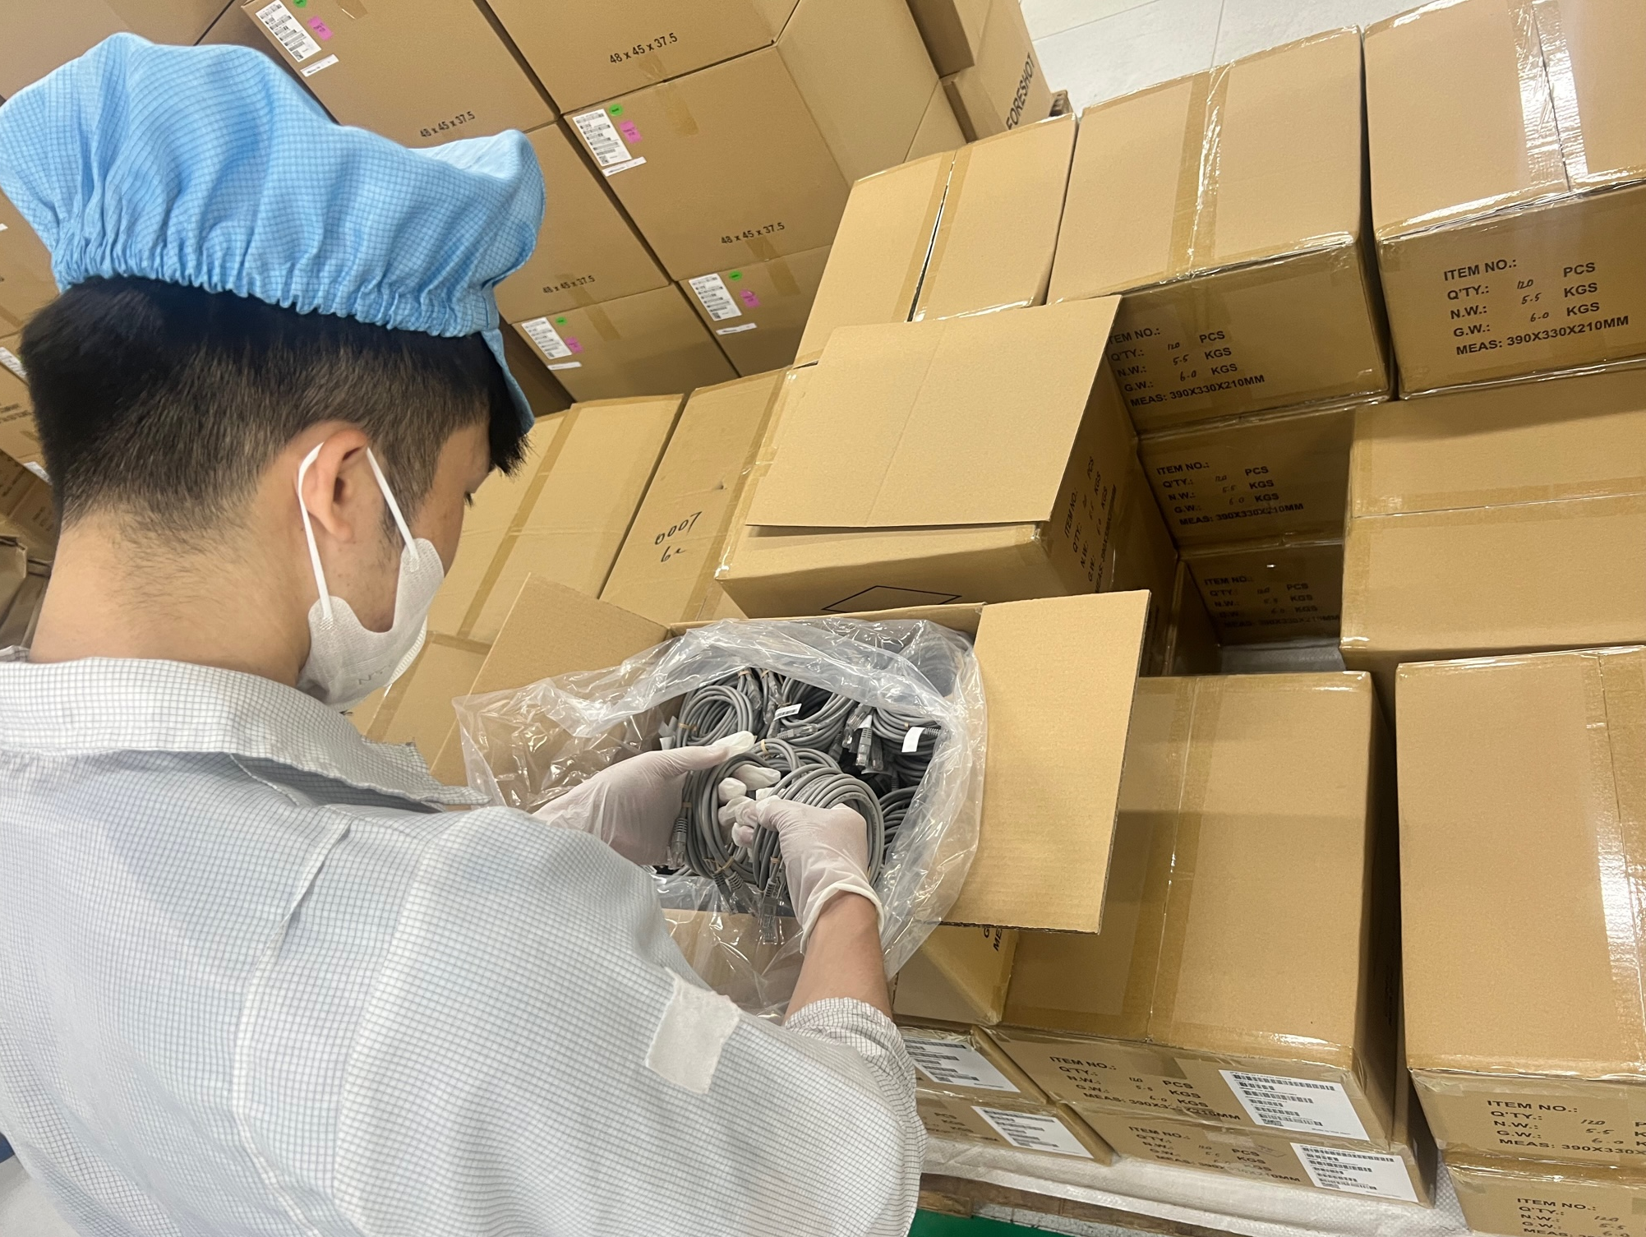

D5
Corrective Action
D6. Permanent improvement measures | Picture | Owner | Plan complete | Actual complete
Requested Dreamus change correct material |  | MPM Zenda | 2023/11/19 | 2023/12/18
2. For Buy & Sell materials, check the quantity of original packaging materials when receiving the materials. |  | Hop | 2023/11/19 | 2023/11/19
3. Use the material issuance system to deduct accounts in a timely manner and do inventory check daily for Buy & Sell materials. |  | Hop | 2023/11/19 | 2023/11/19
Receiving and counting materials
Distribution material system

Slide 10
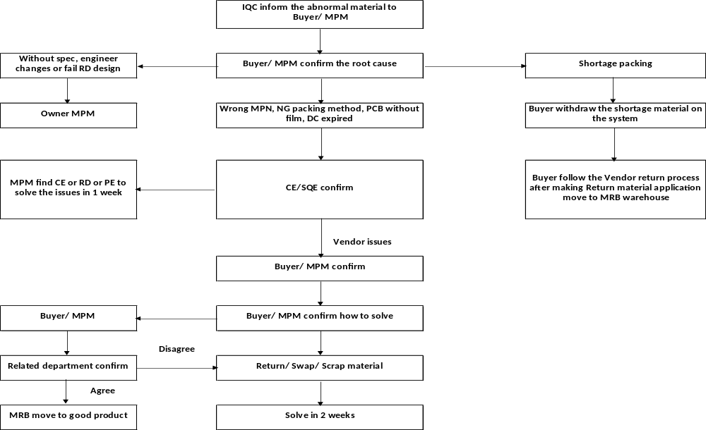
D5
The process in case of BS material abnormal shortage

Slide 11
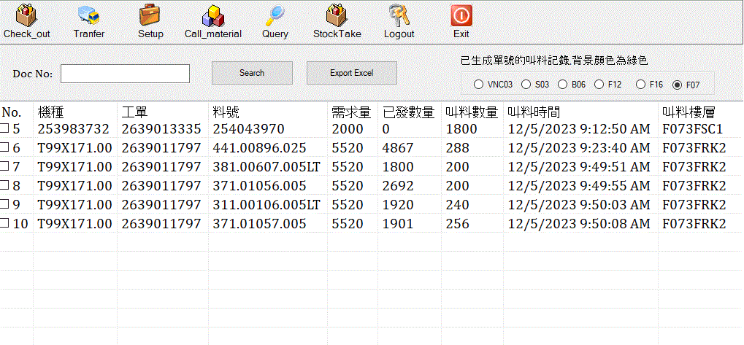
D6
Verification of Effectiveness
KITTING is doing 100% Q’ty inspection for B&S materials.
KITTING is using distribution material system and daily inventory.
The effect needs to be continuously monitored and confirmed!
D6: Verification of Effectiveness
Model
Work order
Material P/N
Req Qty
Check out Qty
Production line call material time
Line name
Production line call material Qty
Distribution material system

Slide 12
D7
Prevent Recurrence
Continuous implementation of countermeasures
Owner : KT/Hop. Done on 11-30

